Slide 1

Emerging Issues in Ethics for Lawyers and Social Media
Jeffrey H. Geiger, Esquire
Sands Anderson PC
jgeiger@richmond.edu
804-783-7248

Slide 2
(Dated) Mobile Phone Usage
75% of smart phone users reported being within five feet of their phones most of the time
12% of smart phone users admitted using their phones in the shower
More than 90% of cell phone users "keep on their person a digital record of nearly every aspect of their lives—from the mundane to the intimate."
Riley v. California, 134 S. Ct. 999 (2014).

Slide 3
"The average person will spend 5 years of his or her life on social media – more time than they will spend eating, socializing, and grooming. As people continue to spend more time on social media, that number will only increase.”

Slide 4
Online Reputation
83%: online reviews influence their perception of a business
50%: would use a local business with a positive online reputation
35%: have vented online—26% to express dissatisfaction; 23% to share companies they like
Kristin Warner, FirePath Communications

Slide 5
And 73% believe what they read online is true and accurate!!!

Slide 6

Legal Ethics and Social media:
Cautionary Tales

Slide 7
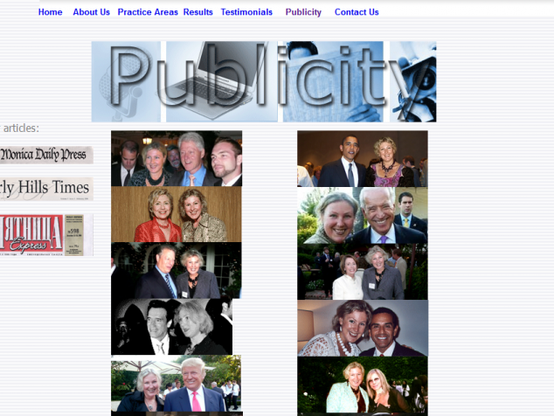
Number 1: “False and Deceptive” Advertising
The photo-shopped photos show the attorney hobnobbing with President Obama, Vice-President Biden, George Clooney, Donald Trump, Woody Allen and Alec Baldwin, among others.

Slide 8
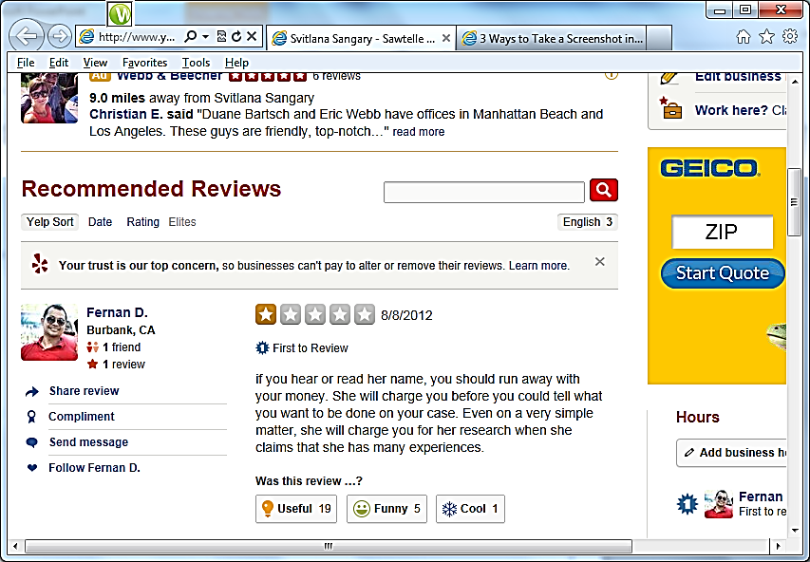
Yelp Review

Slide 9
Number 2: Craigslist: Adult Gigs

Slide 10
“Adult Gigs”
“Loop law firm looking to hire am [sic] energetic woman for their open secretary/legal assistant position. Duties will include general secretarial work, some paralegal work and additional duties for two lawyers in the firm. No experience required, training will be provided. Generous annual salary and benefits will be provided, including medical, dental, life, disability, 401(k) etc. If interested, please send current resume and a few pictures along with a description of your physical features, including measurements. We look forward to meeting you.”

Slide 11
And After Debbi Responds . . . .
“Thank you for your interest in the job. I just wanted to give you some more info about the job and see if you are still interested in interviewing.
Our law firm is a boutique firm, concentrating solely in immigration law. The name of the law firm is Chowhan Law, P.C. You can see the website at www.chowhanlaw.com....
As this is posted in the ‘adult gigs’ section, in addition to the legal work, you would be required to have sexual interaction with me and my partner, sometimes together sometimes separate. This part of the job would require sexy dressing and flirtatious interaction with me and my partner, as well as sexual interaction. You will have to be comfortable doing this with us.
If you think you’re comfortable so far, please let me know and we can proceed with the process.”

Slide 12
It Gets Better . . . .
“The next step is to set up an interview. When are you available to interview? I am free to interview today. Please let me know what your availability is.
Lastly, we’ve actually hired a couple of girls in the past for this position. But they have not been able to handle the sexual aspect of the job later. We have to be sure you’re comfortable with that aspect, because I don’t want you to do anything that you’re not comfortable with. So since that time, we’ve decided that as part of the interview process you’ll be required to perform for us sexually (i didn’t do this before with the other girls i hired, now i think i have to because they couldn’t handle it). Because that aspect is an integral part of the job, I think it’s necessary to see if you can do that, because it’ll predict future behavior of you being able to handle it when you have the job.
If you’re still okay with everything, let me know what you’re availability is and we can figure out a time for you to come in and interview. Let me know. Thanks for your interest.”

Slide 13
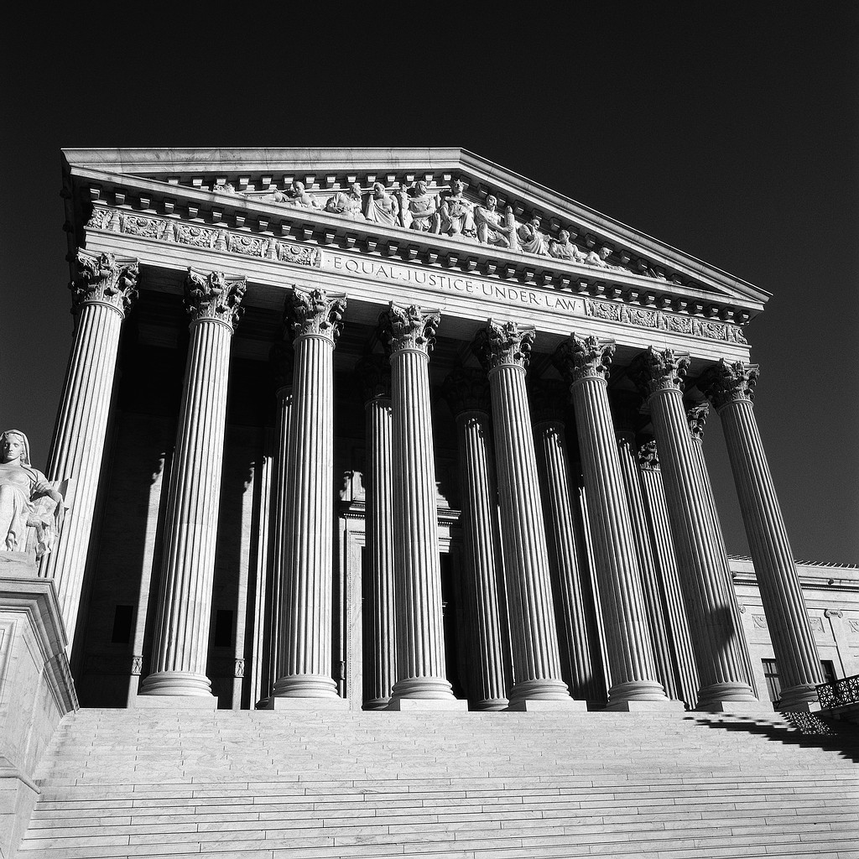
Number 3: New Law Grad Tweets
Her Way to a Reprimand

Slide 14
Research attorney to a judge on the Kansas Court of Appeals sent tweets through her personal account on her office computer while watching an attorney disciplinary matter:

Slide 15
Still further….

Slide 16
Social Media Meets Ethics
Technology Challenges
Competence
Confidentiality
Conflicts
Advertising
UPL/Access

Slide 17
Question
Is a Lawyer’s Use of Social Media Ethically Mandated?

Slide 18

Hypothetical

Slide 19
Troubles
Disgruntled employee sends email to 11 lawyers, alleging company abuses. One of the lawyers represents the company.
Driver in an accident responds to lawyer’s chatbot requesting assistance, admitting that she had been drinking. The lawyer represents a passenger.

Slide 20
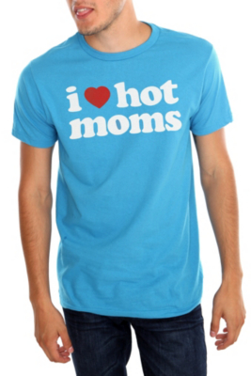
Hypo: Advising Clients

Slide 21
Handling of Evidence
What does an attorney tell a client when there may be evidence damaging to the case?
Burn it? Ignore it? Lie about it?
Can an attorney tell you to “modify” it?
Social media makes everything even more difficult….

Slide 22
Allied Concrete Co. v. Lester
Terrible trucking accident resulting in death of wife
Attorney for husband directed to be destroyed evidence of his client’s social media (FaceBook) usage, including picture of client holding beer shortly after the death of his wife with a t-shirt saying “I ♡ Hot Moms.”
He asked his paralegal to convey this message to his client to “clean up” his FaceBook and MySpace pages because “[w]e don’t want any blow-ups of this stuff at trial.” This happened onmore thanone occasion.
Still, jury award was approximately $10,000,000

Slide 23
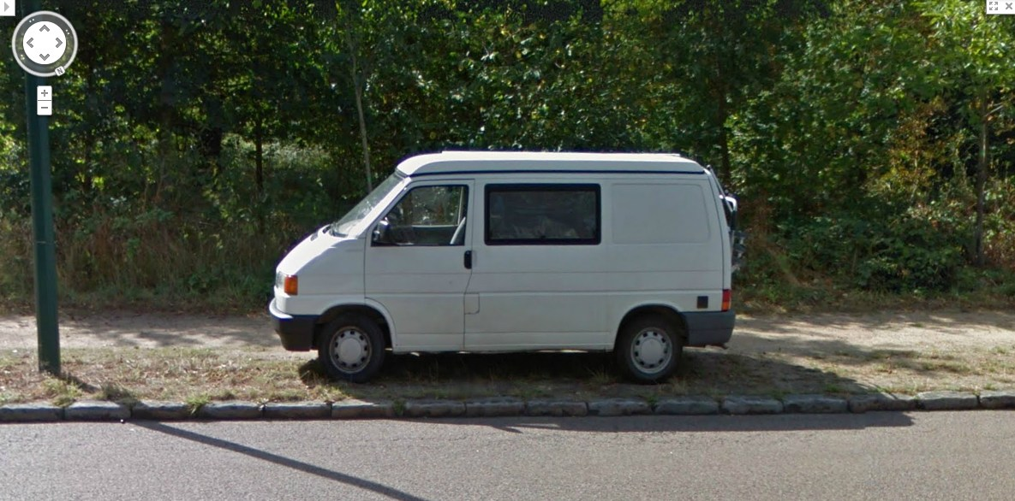
Hypothetical: Investigating Witnesses

Slide 24
Investigations of You
Google (including Google Map)
FaceBook
Instagram
LinkedIn
Westlaw
Lexis

Slide 25
Are You Protected?
Can an attorney ethically follow you on social media?
Can an attorney ethically become your “friend” on FaceBook?
Can an attorney use an assistant to ethically follow you on FaceBook?
Can an attorney ethically look though your trash at the curb?

Slide 26
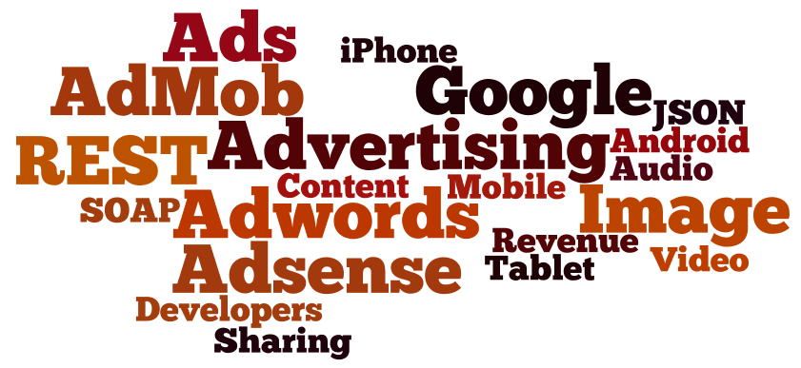
Study: Lawyers & Advertising

Slide 27

Where it all started….

Slide 28
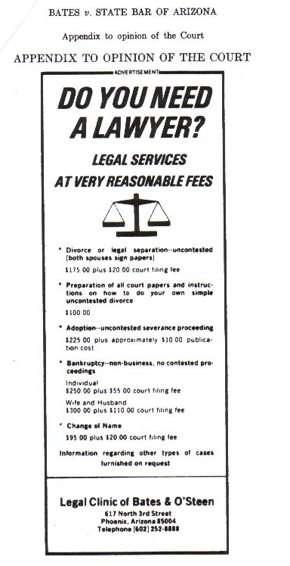
Ad in the Arizona Republic (1976)

Slide 29
Social Media Advertising
Deception
Lies
Misrepresentations
Got it?

Slide 30

Intersection of
Free Speech and Legal Ethics

Slide 31
Hunter v. Virginia State Bar
Lawyer represents defendants in criminal cases.
Lawyer blogs about criminal justice issues
He also blogs about cases he has handled, including discussing what occurred in court.
Free speech or violation of confidentiality and advertising rules?

Slide 32
Hunter v. Virginia State Bar. 285 Va. 485, 504, 744 S.E.2d 611, 620 (2013)
The VSB argues that it can prohibit an attorney from repeating truthful information made in a public judicial proceeding even though others can disseminate this information because an attorney repeating it could inhibit clients from freely communicating with their attorneys or because it would undermine public confidence in the legal profession. Such concerns, however, are unsupported by the evidence. To the extent that the information is aired in a public forum, privacy considerations must yield to First Amendment protections. In that respect, a lawyer is no more prohibited than any other citizen from reporting what transpired in the courtroom. Thus, the circuit court did not err in concluding that the VSB's interpretation of Rule 1.6 violated the First Amendment.

Slide 33
Practical Reality
Former clients contacted by the Virginia State Bar were not pleased over the publication of their matters by their former attorney. The Supreme Court’s position is contrary to the opinions of most legal experts.

Slide 34

Questions?

