Slide 1
The Bigger Sandbox
Dustin O. Davies, CISSP
Nicole J. Harrell, Esq., CIPP/US
Kaufman & Canoles
March 1, 2019

Slide 2


Your Prior Work Environment

Slide 3




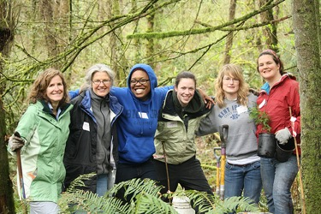

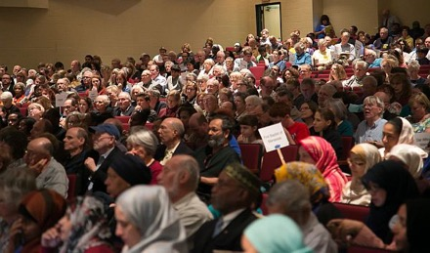




Your Current Work Environment

Slide 4
Confluence of Events
Shift in Workforce
Commoditization of Technology
Shift in Liability
Notes:
Noteworthy that there are multiple things happening.

Slide 5
A Look at Your Workforce
Silent (1923-1945)
Baby Boomers (1946-1964)
Gen X (1965-1979)
Gen Y (1986-1994)
Gen Z (1995-present)

Slide 6
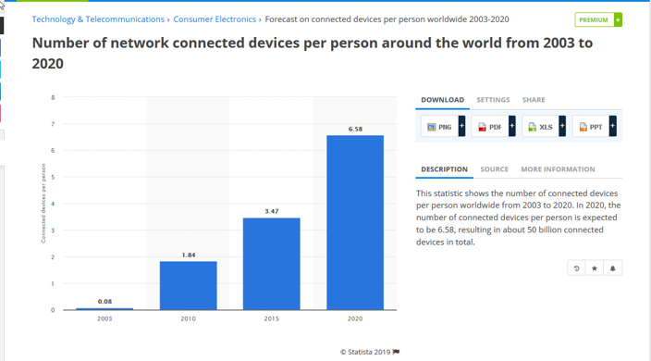
Commoditization of Tech.
  https://www.statista.com/statistics/678739/forecast-on-connected-devices-per-person/
Notes:
.08 connected devices per person (worldwide) in 2003
1.8 connected devices per person (worldwide) in 2010
6.58 connected devices per person (worldwide) in 2020

Slide 7
Enter ESI
Carbon paper
Rotary dial phone
“Confidential” paper
file located in a filing
cabinet in the hallway
Computer
Smart device
Secured, permissioned electronic file

Slide 8
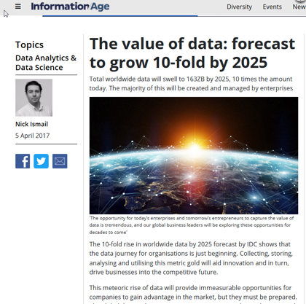
Data growth
Notes:
Data – volume worldwide to grow 10 X by 2025. Most will be created and managed by enterprises.

Slide 9
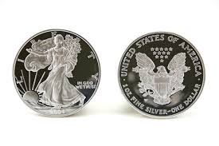
Security and Privacy
Notes:
Often repeated: Privacy and Security are two sides of the same coin. Many privacy issues are security issues. Many security issues can give rise to privacy issues.

Slide 10
What does “Privacy” Mean?
Formally: “the state or condition of being free from being observed or disturbed by other people.”
In technology context:
Notes:
Textbook: the state or condition of being free from being observed or disturbed by other people.
In the technology context, it’s still being decided and it’s a bit of a mess.

Slide 11
Privacy Tenets
  FTC 1998:
  Notice/Awareness
  Choice/Consent
  Access/Participation
  Integrity/Security
  Enforcement/Redress
Notes:
20 years ago, the U.S. Federal Trade Commission reported these principles in the context of the Internet when it produced, at the request of the legislative branch, a document called "Privacy Online: A Report to Congress."

Slide 12
Privacy Tenets
  General Data Protection regulation (GDPR):
  Lawfulness, fairness and transparency
  Purpose Limitations
  Data Minimization
  Accuracy
  Storage Limitations
  Integrity and Confidentiality
Notes:
1. Lawfulness, fairness and transparency
Transparency: Tell the subject what data processing will be done. Fair: What is processed must match up with how it has been described. Lawful: Processing must meet the tests described in GDPR [article 5, clause 1(a)].
2. Purpose limitations
Personal data can only be obtained for “specified, explicit and legitimate purposes”[article 5, clause 1(b)]. Data can only be used for a specific processing purpose that the subject has been made aware of and no other, without further consent.
3. Data minimisation
Data collected on a subject should be “adequate, relevant and limited to what is necessary in relation to the purposes for which they are processed” [article 5, clause 1(c)]. In other words, no more than the minimum amount of data should be kept for specific processing.
4. Accuracy
Data must be “accurate and where necessary kept up to date” [article 5, clause 1(d)]. Baselining ensures good protection and protection against identity theft. Data holders should build rectification processes into data management / archiving activities for subject data.
5. Storage limitations
Regulator expects personal data is “kept in a form which permits identification of data subjects for no longer than necessary” [article 5, clause 1(e)]. In summary, data no longer required should be removed.
6. Integrity and confidentiality
Requires processors to handle data “in a manner [ensuring] appropriate security of the personal data including protection against unlawful processing or accidental loss, destruction or damage” [article 5, clause 1(f)].
These 6 principles give a top level overview of the areas covered by the new regulation, however they do not delve into nuances of consent and other articles of GDPR, nor the complexities of data flow mapping, lineage and coordination activities associated with implementing a programme to meet GDPR compliance.

Slide 13
Privacy Tenets
  “Big Data Ethics”
Private customer data and identity should remain private:
Shared private information should be treated confidentially
Customers should have a transparent view
Big Data should not interfere with human will
Big data should not institutionalize unfair biases
Notes:
Private customer data and identity should remain private: Privacy does not mean secrecy, as private data might need to be audited based on legal requirements, but that private data obtained from a person with their consent should not be exposed for use by other businesses or individuals with any traces to their identity.
Shared private information should be treated confidentially: Third party companies share sensitive data — medical, financial or locational — and need to have restrictions on whether and how that information can be shared further.
Customers should have a transparent view of how our data is being used or sold, and the ability to manage the flow of their private information across massive, third-party analytical systems.
Big Data should not interfere with human will: Big data analytics can moderate and even determine who we are before we make up our own minds. Companies need to begin to think about the kind of predictions and inferences that should be allowed and the ones that should not.
Big data should not institutionalize unfair biases like racism or sexism. Machine learning algorithms can absorb unconscious biases in a population and amplify them via training samples.

Slide 14
What does “Security” Mean?
Formally: “The state of being free from danger or threat.”
In technology context, three tenets:
  Confidentiality
  Integrity
  Availability

Slide 15
Rubber Meets the Road
Home Depot – statement released Sept. 8 2014
Target – November/December 2013
HIPAA HITECH
GDPR
Notes:
SHIFT IN LIABILITY – companies have to take this seriously
“Whether it’s patient records, billing information or cardholder data, the ultimate responsibility rests with the originating organization, despite our best (and well-intentioned) efforts to transfer some of that burden to third-party service providers and other partners in our business ecosystems. The regulatory bodies are taking notice as well, such as governmental or industry organizations like the PCI Standards Council. All are issuing guidance and making strong statements to the press about the need to protect data across the vendor and partner ecosystem.”
Brandon Dunlap, Client Security Officer, Hewlett-Packard
(Reported in 2017)
Home Depot - In a new settlement with dozens of banks, the retailer has agreed to pay $25 million for damages they incurred as a result of the breach, one of the biggest in history.
Target -Target will pay an $18.5 million multistate settlement, to resolve state investigations of the 2013 cyber attack that affected more than 41 million of the company's customer payment card accounts.
HIPAA = signed into law Feb 17, 2009
Stakes raised significantly as big data, analytics, AI come to mainstream.

Slide 16
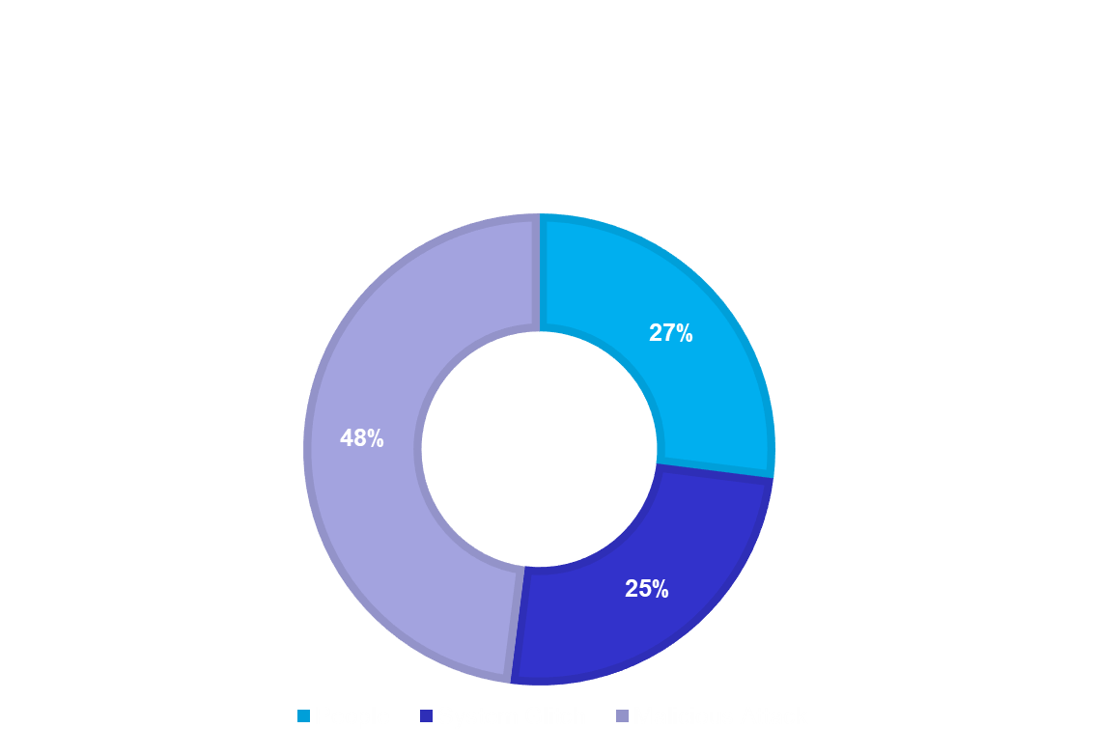
Threats
People
Technology
Environmental Factors
Source: Ponemon Institute, 2018 Cost of a Data Breach Study
Notes:
The largest threat you are likely to face is your own people. Most of us don’t wake up in the morning and decide we are going to cause significant financial and reputational harm to our employer by causing a data breach or wrongfully disclosing information. What is often more likely, is that on a Friday or a day before a holiday, your employee, who is going on 4 hours of sleep because after work he or she picked up kids, got them to after school sports and other activities, then had to feed them, get them ready for bed at a reasonable time, then clean up the kitchen, remember to feed the dogs, prep dinner for tomorrow night, make lunches, and get a few things done for work, change the laundry and try to remember if tomorrow is recycling day or is it next week, was fully distracted by lots of other things going on, and clicked a link in an email, or responded to a phishing email.
There are a couple of issues with technology – first, the technology available to you on the market can’t keep up with the fast moving pace of the hackers; second, you likely don’t have the ability to spend the majority of your budget on IT enhancements and data privacy and security tools; and finally, companies are not necessarily consistent with their own policies and procedures, such as patch management.

Slide 17
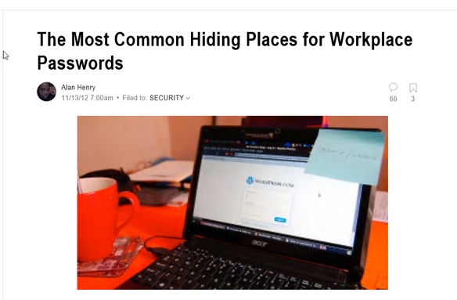
Examples

Slide 18
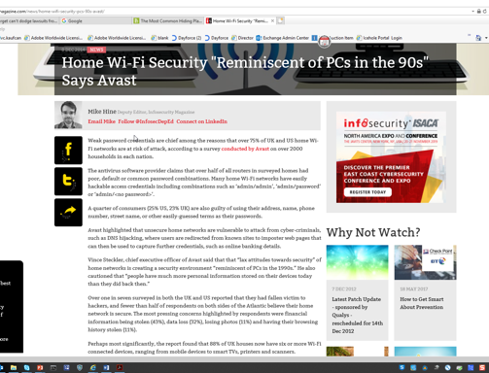
Examples
Notes:
Vince Steckler, chief executive officer of Avast said that that “lax attitudes towards security” of home networks is creating a security environment “reminiscent of PCs in the 1990s.” He also cautioned that “people have much more personal information stored on their devices today than they did back then.”

Slide 19
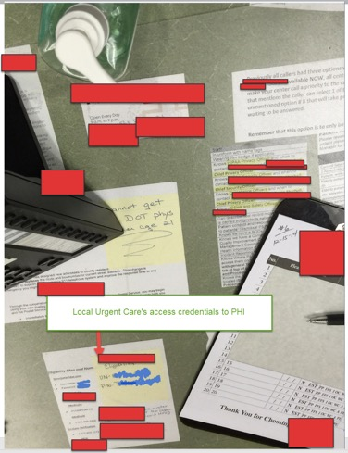
Examples
Notes:
Urgent care check-in desk. Visible are all the security and privacy requirements (who to call, who is responsible if data is breached etc.) along side a post it note with user name and password information to one of the insurers call-in lines.

Slide 20
Examples
Redaction Failures:
https://www.schneier.com/blog/archives/2005/05/pdf_radacting_f.html
http://www.law360.com/articles/505658/quinn-sanctions-show-law-firms-need-better-data-oversight
https://freedom-to-tinker.com/blog/tblee/studying-frequency-redaction-failures-pacer/
https://www.law.com/nationallawjournal/2019/01/08/manafort-lawyers-botch-redactions-revealing-details-on-alleged-trump-contacts/?slreturn=20190128163724
Notes:
Many examples of redaction failures.

Slide 21
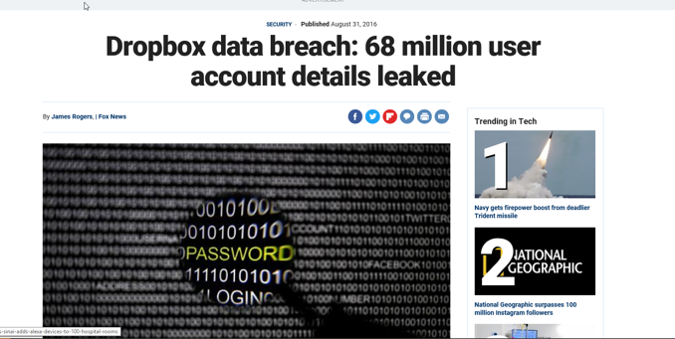
Examples
File Sharing Sites – Breach Notification Required?
Notes:
Dropbox disclosed this breach. What about users who stored sensitive confidential data with Dropbox?

Slide 22
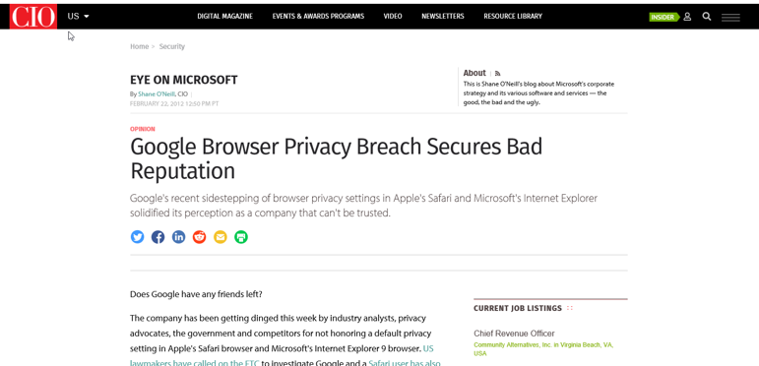
Examples
That time Google ignored privacy settings.
Notes:
What about cookies and Web tracking?

Slide 23
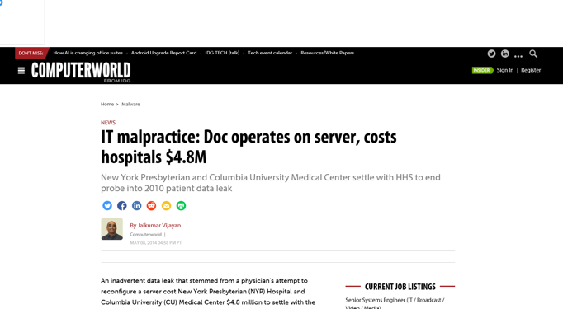
Examples
That time a doctor operated on own servers.
Notes:
Liability for not limiting access or using role-based security.

Slide 24
Controlling ESI
What data do you have?
Where is it located?
Who has access?
How can it be accessed?
Where and how can it leave the system?
Notes:
Information Governance Initiative

Slide 25
Data Mapping
Where does the data come from?
What is the purpose of the data?
How does the data enter your company?
How is the data classified?
What is the format of the data?
Where is the data stored?
Where can the data be accessed?
Who has access to the data?
Notes:
Information Governance Initiative
Understand the critical elements of mapping
From where/whom – customers, staff, third parties
Purpose – payroll, billing, order fulfillment
How does it enter – email, online form, telephone call
What is the classification – sensitive, PHI, PI, non-critical
What is the format – excel, word, pdf, CRM account page
Where is it stored – cloud, in-house server, filing cabinet
Who has access

Slide 26
Home and Mobile Working
Policies
  Virtual office
  Mobile working
Threats
  Network attacks
  Viruses
  Data Loss
Protect Data in Transit and at Rest
Device Security / Requirements
Notes:
Home and Mobile Working – Develop a mobile working policy and train staff to adhere to it. Apply the secure baseline build to all devices. Protect data both in transit and at rest.
Steps:
There have to be rules and policies in place to protect the employer from this risk, and both parties must agree to them.
Institute a security policy, including a requirement that all employees who work at home must sign a contract.
By keeping operating systems and application versions standardized, IT can also centrally manage virus updates.
Device security - Ensure devices have updated virus protection software and appropriate firewall status before allowing them on VPN

Slide 27
Secure Configuration
Apply patches regularly / upon availability
Baseline Build for all Devices
Patch Management Policy/Process
Practices to avoid:
  Use of default passwords
  Inconsistent software installation
  Retention of unnecessary software
  Improper file and directory permissions
  User accounts with unnecessary access privileges
Notes:
Secure Configuration – Apply security patches and ensure that the secure configuration of all systems is maintained. Create a system inventory and define a baseline build for all devices.
Are you at risk? The following practices should be avoided:
Using default passwords for a variety of systems and devices.
Lack of a formal configuration management process or system.
Unnecessary software installed on networks and servers.
Lack of a consistent software installation process.
Improper file and directory permissions.
User accounts with unnecessary access privileges.
Auto-run features that are enabled without requiring administrator consent (these can activate the installation of malware).
Lack of personal firewalls on all devices, including mobile devices.
Lack of a documented configuration management system for networks, software and web platforms.
Configuration management system is not reviewed and updated frequently.

Slide 28
Removable Media Controls
What is the Risk?
  Loss of sensitive information
  Introduction of malware
  Reputational damage
Removable Media Policy
Best Practices to Implement:
  Limit use of removable media
  Scan all media for malware
  Formally issue media to users
  Encrypt information held on media
  Manage reuse/disposal of removable media
  Educate users and maintain awareness
Notes:
Removable Media Controls – Produce a policy to control all access to removable media. Limit media types and use. Scan all media for malware before importing on to the corporate system.

Slide 29
Managing User Privileges
Access Control Policy
User Provisioning
  Formal request and approval
  Follow the principle of least privilege necessary
  Regulate the creation of new accounts, administration of rights, and the editing of account details
User De-provisioning
  Disable or delete access
  Admin password change when support leave
User Access Reviews
Restrict Administrative Access
Notes:
Managing User Privileges – Establish account management processes and limit the number of privileged accounts. Limit user privileges and monitor user activity. Control access to activity and audit logs.
Privileged users have become the main target for cyber criminals.

Slide 30
Monitoring
Develop a Monitoring Strategy
Continuously Monitor all Systems & Networks
Capture and Analyze Logs for Unusual Activity
Real-Time Monitoring:
  Monitor network performance / availability / traffic
  Monitor user activity (detect and stop malicious activity before security is compromised)
  Monitor computer operations (key backups)
Notes:
Monitoring – Establish a monitoring strategy and produce supporting policies. Continuously monitor all systems and networks. Analyze logs for unusual activity that could indicate an attack.

Slide 31
Malware Protection
Malware Policy
Train Users to be Vigilant
  Look for emails with attachments, links, or requests to enter your User ID and password
  Report suspicious emails / messages
Implement Protective Tools
  Anti-virus security package
  Scan for malware across the organization
  Automatically filter out malicious attempts
Notes:
Malware Protection – Produce relevant policy and establish anti-malware defenses that are applicable and relevant to all business areas. Scan for malware across the organization.

Slide 32
Network Security
Security Policy
Apply the Principle of Least Privilege
Dual Authentication
Segmented Networks
  Separate zones for data based on security requirements
Network Security Scanner
Vulnerability Scanning
Patch Management
Notes:
Network Security – Protect your networks against external and internal attack. Manage the network perimeter. Filter out unauthorized access and malicious content. Monitor and test security controls.
Network / system failure and a hacker is in your system
Segmenting network into zones with security requirements, enforcing policy of what is allowed to move from one zone to another

Slide 33
Guidelines/Suggestions
Effective Policies and Procedures
Culture of Awareness
  Know your risks
  Prioritize your budget to address
  Training
  Ongoing effort - forever
Technical and Administrative Controls
  Proactive
  Monitoring/Reactive
Breach Notification Protocol

Slide 34
Summary
The environment is constantly changing, so you need to adapt
Practice what you put on paper
Understand your data and systems (not just for the IT Department)
Understand your risk tolerance and how that intersects with your need for connectivity and access

Slide 35
Questions
Dustin O. Davies, CISSP
Nicole J. Harrell, Esq., CIPP/US
njharrell@kaufcan.com
(757) 624-3306

