Slide 1
The Growing Cybersecurity Threats to Law Firms
Kelly Jackson Higgins, Executive Editor, Dark Reading
Notes:
=Who I am
Veteran cybersecurity journalist
Insight as a veteran cybersecurity reporter and editor, 20+ years covering this sector
Prior to that: IT space
Sports writer
As exec editor I run the news operation at DR, including assigning stories, editing stories, writing among other site duties
=What I am NOT:
A cybersecurity consultant, technician or hacker.
But those folks my sources (and friends)=
Giving my perspective as a journalist covering this space for long time; live & breathe it every day
=What I’m going to talk about today:
Main forms of cyber threats that are hitting the legal sector today
How they work
What they/the attacker are after
Who the attackers could be
Real-world examples of law firm hacks
Most importantly, some best practices to prepare for - and protect – yourselves personally & your firms from these types of attacks
=Planning to leave time after for Q&A and/or any discussion surrounding these topics, your firsthand experiences, etc.
Hoping to make this interactive among you all as well
Learn from your colleagues

Slide 2
About Dark Reading
Cybersecurity’s Most Widely Read News Site
  ~1M page views/month
  Ranked #1 among CISOs (Apollo Research, 2016)
  Six full-time editors, plus several contributing editors
  www.darkreading.com
An Informa (formerly UBM) Brand
  Content also appears on InformationWeek, Network Computing
  Sister brand of Black Hat and Interop conferences
Notes:
What is Dark Reading?
=Slide info
=Dark Reading covers the latest cyberattack campaigns by cybercriminals and nation-state actors, as well as industry trends, techs, people

Slide 3
Dark Reading 2018 Strategic Security Survey Overview
Methodology: Online survey of 300 IT and cybersecurity professionals at North American companies with 100 or more employees.
Focus: Cybersecurity challenges, plans, and directions, as well as respondents’ experiences and concerns about data breaches
Notable findings: 48% consider end user awareness training the most valuable security practice
69% have password policies, and 67% have invested in end user awareness training
Notes:
To give you some context about what organizations in all sectors are facing,
Share w/you: Dark Reading 2018 Strategic Security Survey (annual)
=Slide info
=Data collection concluded in May of 2018.
[There are three reports written using this data as the main content if they are interested in the report findings].
The margin of error for the total respondent base (N=300) is + or – 5.6 percentage points.

Slide 4
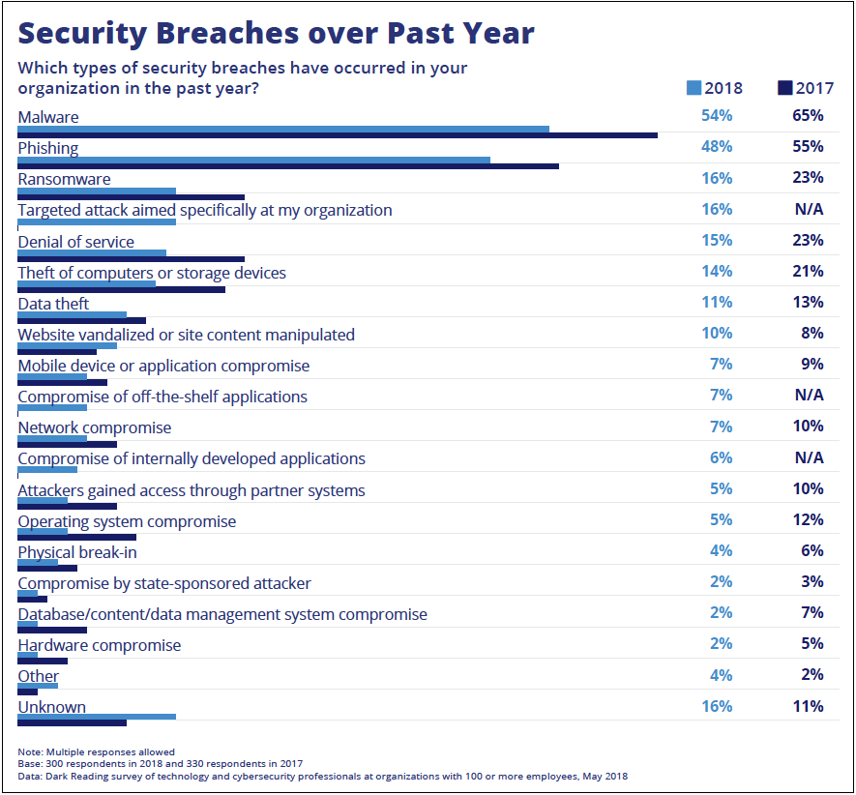
2018 Dark Reading Strategic Security Survey
More than half of all organizations suffered breaches via malware
Phishing attacks leading to security breaches hit just under half of organizations
Notes:
Types of breaches in the past year across all industries– N.A.:
54% infected w/malware
48% had phishing attack that led to sec breach***[vs data breach]
Ransomware 16%
Targeted attack 16%

Slide 5
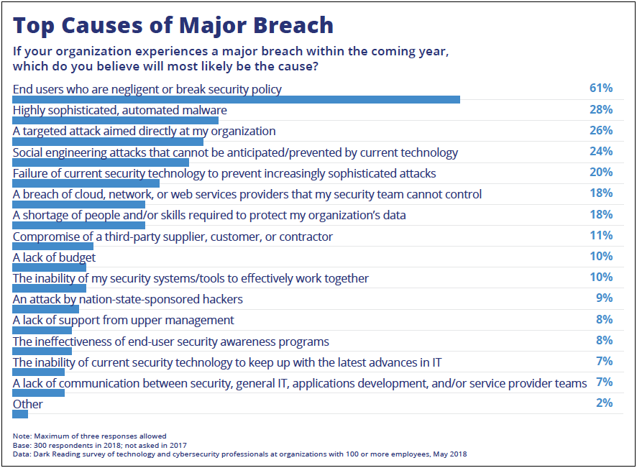
2018 Dark Reading Strategic Security Survey
More than 60% say end user mistakes or threats will cause major breach
Only approximately one-quarter believe their organization will suffer a targeted attack
Notes:
Top causes: if your org is hit w/a major breach in the coming year, which will most likely be the cause:
Those pesky end users.
61% said a user mistake or negligence would be the root cause of security breach
=Next up, but not nearly as prevalent:
Sophisticated, automated malware 28%
Targeted attack 26%
Social engineering attack 24% /bit of overlap w/users **
=Survey: Did not break out by industry sector – so this is a big pic view for some perspective

Slide 6
Most Common Cyber Threats Facing the Legal Sector
Cybercrime: Ransomware, Phishing, BEC scams
Cyber Espionage: Pure spying attacks by nation-state hacking groups
Strategic Attacks: Hacking law firms to reach their clients, other business relationships – stepping-stone type attacks to reach ultimate target
Notes:
What we’re seeing in our reporting at Dark Reading:
Main ones here—cybercrime, cyber espionage, strategic attacks.
I’ll go into each next

Slide 7
Cybercrime
Ransomware (Ryuk or “Death Note”)
Phishing
Business Email Compromise (BEC) scams
Notes:
CYBERCRIME
Cybercrime-type attacks typically random, attacks of opportunity
All about making money/obviously
Easy, anonymous way to do it in most cases. If your in a nation such as Russia where there’s no extradition agreement w/the US, example, get away w/it. Unless holiday at the beach in Spain or Caribbean (has occurred)
Using malware
Social engineering
Stolen credentials of a user at your org, oftentimes taking advantage of reused pwds
Gonna talk about each of these

Slide 8
Ransomware
Malware encrypts, locks out users from files, data
Ransom note/message demands payment for releasing files, data
Phishing email, stolen credentials, RDP, VPN
Ransomware kits – easy & inexpensive (free- to $250)
Payment in Bitcoin, other cryptocurrencies
Average ransom demand in 2017 was $522 - less than half of what it was in 2016, $1,070, according to Symantec
Nearly 75% of organizations stockpiled cryptocurrency in past year (Code42)
8 in 10 of them paid ransomware in past year (Code42)
Notes:
Now go into each of these attack types by cybercriminals:
First Ransomware
= Ransomware = type of malware
Encrypts, locks out
=Note: demands payment to release
=Malware typically gets in via phishing email someone clicks on
recent example of phishing email sent: Ryuk: Japanese manga/graphic novel character from the series “Death Note.” drops a death note
ransom notes. Fun name.
Or already have stolen credentials of a user
Can get in via s Remote Desktop Protocol (RDP) port:
IT remotes into a user’s machine to control, fix machine, etc.
If that port on network left open, bad guy gets in
brute force way in
Get acct, move laterally etc
Or via an org’s virtual private network (VPN) without 2FA
=Ransomware kits free or cheap $250
=payment: bitcoin, cryptocurrencies
=Average ransom demand in 2017 was $522, less than half of what it was in 2016, $1,070, according to Symantec 2018 report. Interestingly, didn’t report on the $ in their new report just out—so miniscule from what they saw overall w/the drop
=Even so, some are getting fatalistic about ransomware:
early three-quarters of the security executives and 60% of CEOs admitted to stockpiling cryptocurrency to pay cybercriminals in case of a ransomware attack or data breach. 8 in 10 of the security executives whose companies have stockpiled cryptocurrency have made payments to cybercriminals in the past year.
=Don’t pay

Slide 9
Ransomware (cont’d)
Overall, ransomware attacks have declined 91% in past year (Trend Micro)
Cryptomining/cryptojacking up 237%
Uses victim machine processor power to mine cryptocurrency
Ransomware: consumers, hospitals (2017) and now enterprises (2018)
81% infections in business/enterprises
Shift to email-based attack vector (phishing)
More law firms getting hit
Real-world example: 2017 NotPetya data-destruction attack on DLA Piper
Notes:
=Interestingly, ransomware overall has dropped in the past year:
Security firm Trend Micro: 91% drop in ransomware detections
=One reason: cybercriminals and some n/s moved to mining cryptocurrency instead: that went up 237%
Aka cryptojacking: drop code/malware on victim machines and use their processor power to mine cryptocurrency. Ez, mostly invisible way make $
Cryptomining is the illegal use of an organization's or individual's computing power without their knowledge
to mine cryptocurrencies - were nearly twice as many of cryptomining than ransomware attacks in 2018.
price of cryptocurrencies like Bitcoin hitting a high of nearly $20,000 going into 2018, IBM X-Force,
lower-risk/lower-effort attacks secretly using a
victim's computing power
=Ransomware: used to be mostly a consumer problem until 2017, consumers majority of infections.
In 2018 81% of ransomware infections in enterprises -- overall ransomware infections down, enterprise infections were up by 12%
=Moved to email-based attacks vs exploit kits
Eprisee/bizes love email
=Law firms getting hit more & more, IR investigators seeing
=Real-world example: 2017 NotPetya data-destruction attack on DLA Piper
Phone lines, Web portal to document system, email, etc. down. Online and electronic ops distrupted for 13 days when all said & done.
NotPetya posed as ransomware, asking for $300 in bitcoin. But was more about destruction of. Not true ransomware; didn’t collect, decrypt.
=Recent LE win: 2 Iranian nationals indicted in US for their alleged involvement in SamSam attacks.
Made $6 million in ransom payments, caused over $30 million in losses to victims.

Slide 10
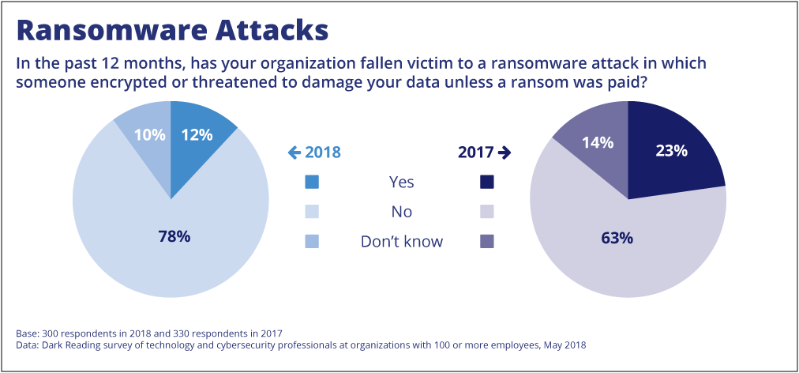
2018 Dark Reading Strategic Security Survey
Notes:
From the DR report:
You can see how the ransomware decline happened relatively quickly overall from 2017-2018
Nearly ¼ of respondents hit ‘17, just 12% in ‘18

Slide 11
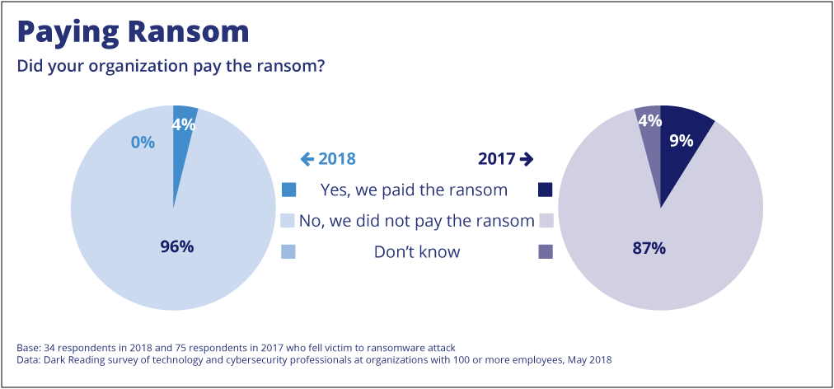
2018 Dark Reading Strategic Security Survey
Notes:
From the DR survey:
=You can see most orgs DON'T pay ransom
=and the % that did decreased 50% from 2017 to 2018
=much of that trend - and trend of declining ransomware attacks plus doing better job at backing up data.
=so if hit w/ransomware, you have your data saved elsewhere. OFFLINE backups
No need to deal w/the attacker.

Slide 12
Phishing and BEC Scams
Phishing: malicious email (infected URL, attachment)
Clicking = Infection
Social engineering
Typical Step 1 of cyberattack
BEC: posing as law partner, colleague
Phony invoices, payment requests
FBI: BEC & Email account compromises up 136% (12/16-5/18)
41K US incidents, $2.9B losses
Notes:
=Phishing pretty self-explanatory
Malicious email…url, attachment,
=click or open it = infected
=step 1
=BEC/business email compromise attacks up 28% this past yr (Trend Micro)
Phishing via attachment, URL
: takes advantage of human nature: helpful, respond to “urgent” requests
=BEC a more specialized phishing method/way for an attacker get in
Need some info on the target: such as biz partner, or law partner’s name, email address/spoof
Attackers do recon: look for legit invoices target uses/online info
In some cases, alrdy inside w/remote access Trojan sniffing around for invoices, names etc.
Create email appears to come from an executive in the co, biz partner
Request a payment of some type, moving funds to specific bank acct #, ie
Usually URGENT request so no time to vet, think it thru
But $ sent to attacker’s acct.
FireEye Mandiant seen a lot of BECs v law firms lately
=FBI data BEC and email account compromise (EAC) scam losses worldwide jumped 136% from December 2016 to May 2018.
=Some data pts from FBI:
78,617 BEC/EAC incidents reported between October 2013 and May 2018, resulting in $12 billion in losses.
41,058 of those US, resulting in $2.9 billion in losses. (July 2018 report)
China and Hong Kong banks main locations for receipt of fraudulent funds, while the UK, Mexico, and Turkey are emerging regions, FBI said
=TAX lawyers heads up:
Scarlet Widow Nigerian BEC grouprelied on wire transfers in its early BEC scams, it has now transitioned to seeking payment through Apple iTunes and Google Play gift cards. This method delivers cash quickly, can’t be reversed through quick action by bank officials, and eliminates the need to manage a network of money mules inside the target country.
This behavior mirrors findings from a 2018 report from the U.S. Federal Trade Commission. From January through September 2018, gift cards and reload cards were the payment method in 26% of fraud reports, up from just 7% in 2015, the FTC said. Among those who paid a scammer with a gift or reload card, 42% used iTunes or Google Play cards, according to the report.
Scarlet Widow uses a web scraper to traverse the online directories of nonprofit organizations and collect email addresses, a process it refers to as “bombing” the directory.
Scarlet Widow also seems to be preparing for phishing campaigns targeting tax preparation firms. In September 2018, the group began collecting targeting information on thousands of United States-based tax preparers, likely to target these individuals with W-2 BEC attacks before and during the current tax season.

Slide 13
Real-World Cybercrime Risks for Law Firms
Jan 2018: More than 1 million user credentials from top UK law firms found on Dark Web
2,000 emails/firm on average
Largest firm: 30K exposed emails
Cybersecurity firm RepKnight research
Most from other breaches: LinkedIn, Dropbox, third party accounts that used corporate email addresses
Credential-stuffing attacks
Notes:
Example of some of the cybercrime risk facing legal sector:
=January 2018: found 1 million leaked and hacked credentials from the UK’s top law firms on the Dark Web,
=About 2K email addresses/per firm
=lgst firm: 30K exposed emails
sitting there where bad guys can use for phishing scams and ultimately, stealing data
=UK cybersecurity researchers at RepKnight brought this to light to illustrate leaked/hacked creds on Dark Web.
=BUT Interesting Caveat/relatively good news for law firms affected: Nearly of the creds were from 3rd party breaches, not at the actual law firm itself:
LI, dropbox
Law firm users used their corp email addresses on those sites & site was compromised.
Doesn’t mean the firm would definitely be hacked, but those emails could be used for phishing attacks, and as a first step toward getting more sensitive info on the user: 80% of exposed had pw exposed in plaintext:
=Attackers can/could use those stolen creds to get employee’s sensitive info/online banking; likely in Credential-Stuffing attacks /spear
Reused passwords way too common***
=Credential-stuffing attacks are becoming v popular – way to brute-force attack
Hacker tests large numbers of compromised usernames and passwords breached from one account and use it against another account
So if your user has. LI acct compromised, could be used to hack into his/her other user accts if reused creds
Or for phishing attacks

Slide 14
Cyber Espionage
Nation-state hacking groups conducting spying
China (most active), Russia, North Korea, Iran are the most prolific
China known for intellectual property theft via cyber espionage
Similar types of attack methods as cybercriminals
Phishing, stolen user credentials, sometimes water-holing attacks
Target: Law firm email systems, document management systems
Valuable information, intel on clients, mergers & acquisitions
Notes:
Cyber Espionage is just that:
=Spying via hacking into your target
=nation-states
China most active
Russia, NK & Iran also v prolific
China intellectual property theft, and traditional spying
=Similar attack methods as cybercriminals –phishing, stolen creds, sometimes infected websites for water-holing attacks
Seed websites of a certain top/interest to their potential targets: browser-borne malware, for example, on an NGO’s website that specializes in China in hopes diplomats from US visit
=target: Email system of law firm:
Contain lots of sensitive and useful information for attackers
=Doc Mgt Sys
=both have:
troves of info bout clients, client biz deals, M&A to be levged, Intellectual property

Slide 15
Example of Cyber Espionage Attack
Chinese government-sponsored hacking team Stone Panda, APT10
Intel agency: Ministry of State Security (non-military)
Attack v US, European companies last year included a US law firm specializing in intellectual property law
Law firm clients: pharmaceutical, technology, electronics, biomedical, automotive, others
Notes:
To give you an example:
=APT10 aka Stone Panda, a hacking team out of China
=Believed to be its intel agency in Bejing, Ministry of State Security
: counter-intelligence, foreign intelligence and political security
=ID’d recently targeting at least 3 companies in the United States and Europe (found by Recorded Future & Rapid7)
between November 2017- September 2018.
gain access to networks and steal valuable intellectual property or gain commercial advantage.
The targeted companies included:
IT and business cloud services managed service provider (MSP) and Recorded Future client and supplier, Visma, a billion-dollar Norwegian company ==850,000 customers globally
An international apparel company
=US law firm specializing in intellectual property law with clients in the pharmaceutical, technology, electronics, biomedical, and automotive sectors, among others
These attacks came via Citrix virtual machine accounts and LogMeIn remote-access software (RDP) using stolen valid user credentials.

Slide 16
Strategic Attacks
"It's about how well-known your clients are - not how well-known your firm is.” -Tom Cross, security expert and CTO, OPAQ Networks
Strategic attack: law firm targeted as a stepping-stone to the ultimate target, its client/s or business partner/s
Nation-states, or even nefarious competitors of client or business partner
Notes:
Strategic Attacks:
=Great quote from a veteran cyber expert, well-known in industry Tom Cross
Sums it up for both nation-state cyber espionage AND strategic cyberattacks v law firms
=“Strategic” attack: hack the law firm to get to their clients, or business partners. Use the firm as a stepping stone
=Size of firm doesn’t matter; it’s the information they handle for clients that’s of value to hackers.

Slide 17
Panama Papers: A Wake-Up Call Data Breach
2016: 11.5 million sensitive data records, 2.6 terabytes of data, hacked & leaked by alleged whistleblower
Mossack Fonseca in Panama
Exposed illicit financial dealings for high-profile politicians – Vladimir Putin, former British PM David Cameron, soccer star Lionel Messi
Demonstrated how legal sector vulnerable, lacking security resources
BitSight’s credit-score style rating for legal sector’s cybersecurity effectiveness: 690 out of 900
Notes:
Likely most high-profile known/reported cyberattack on law firm:
So-called Panama Papers case, where Panamanian law firm Mossack Fon-seca was hacked in 2016
=11.5 MN data records, 2.6 terabytes of data hacked & leaked by alleged whistleblower
=Exposed potentially illicit financial dealings of numerous political leaders and public figures around the world including Russian president Vladimir Putin and British prime minister David Cameron. Tax evasion, etc.
=The breach also exposed relative lack of budget and resources in the legal sector that leaves many law firms vulnerable to cyberattacks—sec experts
=Since then, however, seeing legal sector getting more serious about cybersecurity‘
=How’s legal sector doing security-wise:
Last year Security firm BitSight, which uses a credit-score-like metric for rating the cybersecurity effectiveness of organizations
Law firms: a score of 690 out of 900. That puts them ahead of public relations and communications companies, but behind several other industries. \
Accounting firms. for example. have a rating of 740, and firms in the benefits administration space have a 750 rating from BitSight.

Slide 18
Internet of Things (IoT) and Mobile
Networked printers a possible attack vector
Other Internet of Things (IoT) devices in the office: videoconferencing systems, etc.
IoT devices: default passwords, ports open to the public Internet
Change the passwords, close unnecessary ports, firmware updates
Mobile lawyers: smartphones, laptops, public Wi-Fi exposure
Notes:
=Printers are multifunction, with Wi-Fi access, network access may not realize: printer, scanner, fax, local data storage, wireless networking, operating system
=ripe for attack
=Like other IoT devices in the office: video conferencing systems, ie
=Default passwords, open ports
=Printers, IoT: no public Internet ports open; limit and monitor their connections & who can manage them
Change the default passwords, keep firmware updated
=One security expert who used to write for us once worked at a company that had Internet-accessible Polycom video conferencing systems that were always getting attacked. default passwords were not changed.
Attackers could spy
=Booz Allen Hamilton found that of 61% of survey respondents who reported a data loss incident in 2016, at least 50% had at least one such incident linked to a printer..
intercepted print jobs (50%), loss of data from printer hard disks (48%) printers getting hacked to gain network access (18%).
=Ransomware attacks on printers vandalism most common attacks**
=Booz Allen: North Korean hackers disabled printers used to confirm SWIFT network transfers, for example, in the attacks on City Union Bank in India and the Bank of Bangladesh. Disable as a distraction
=mobile: Anyone here who does NOT work via laptop or smartphone mobile-ly today?
=like most workers, lawyers mobile
Smartphones & use of laptops on public or coffee sop wi-fi can expose user & then the firm.

Slide 19
How to Protect Your Firm: Some Best Practices
Assume you are or already have been attacked
Even small firms have information and/or clients valuable to attackers
Do the basics: keep software updated, run anti-malware scans, create strong passwords & don’t reuse them
Don’t click on unexpected attachments or links in email
Regular, offline data backups (best remedy to ransomware attacks)
VPN software for the office, mobile working
Hard drive encryption
Multi-Factor Authentication
Least privilege
Notes:
Some Best Practices
=no one is immune, no matter how big or small
=Do basic hygiene
Update software
Run Antimalware scans
create strong passwords
least 16 characters, use at least 1 numeral, 1 uppercase letter, lowercase letter and one special symbol.
No dictionary words
Password managers are good too if your company doesn’t have a pw mgt policy
Don’t reuse passwords [Remember : Credential-Stuffing]
Don’t click on stuff u weren’t expecting
=Back up data (offline)
3-2-1 backup strategy
have three copies of your data in two different locations, one offsite (ex: in the cloud). Making your backup 3-2-1 compliant ensures that even if one copy of your backup is encrypted or destroyed by ransomware at least one off-site copy that’s safe
=VPN software for the office, mobile working – encrypts your connection so can’t be sniffed, hijacked
=Multi-factor authentication is key
So password plus a onetime code: Okta Verify, Google Authenticator, DuoSecurity
Onetime code changes constantly
Some mfa offers u text code
=Least privilege for users:
Role-based access to information, applications ←
Only access to this set of documents specific to your job function
IE: IT person may not have need to access case files of attorneys
More rigorous version of that (less commonly deployed):
Case-specific
Literally: have to be granted access to specific type info on a case that u need for your job; or that case
Can be less efficient, not easy to deploy
MF auth for document repositories is good practice
Email security protection services like FireEye’s or can use Microsoft Group Policy in Active Directory to do things like: disable macros in Office docs downloaded

Slide 20
Final Thoughts
Make cybersecurity a culture as well as a practice
Ongoing training for users
Security policy
Security services: vendors, managed security service providers
Have an incident response plan in place: who to contact, what to do
Notes:
Final thoughts:
=make cybersecurity a culture as well as a practice in your firm
All employees/users have a stake in the security of the firm, clients, themselves
At home, too
=user training
=Sec policy
=Plenty of services out there now to handle your sec monitoring…most security vendors, as well as managed service providers
=incident response plan
Expect attack/incident & be ready for it, who to contact, what to do (don’t necessarily power off a machine infected, etc.)

Slide 21
Q&A
@kjhiggins kelly.jackson.higgins@ubm.com
Notes:
Questions?
Any experiences you can share
Happy to talk offline

